Slide 1
Neural Networks: Feedforward Backpropagation NN & Self-Organizing Map
Dr. Hsinchun Chen
AI Lab, University of Arizona
Updated Spring 2020
Acknowledgements:
E. Rich & K. Knight, “AI”; T. Kohonen, “Self-Organizing Map”; R. Lippmann, “Introduction to Computing with Neural Networks”, NSF Digital Library Program

Slide 2
Outline
Introduction and Motivation
Terminology
Feedforward Backpropagation Neural Networks
Representation
Algorithm
Self-Organizing Map
Representation
Algorithm
Research Example: SOM for Text Mining & Visualization

Slide 3
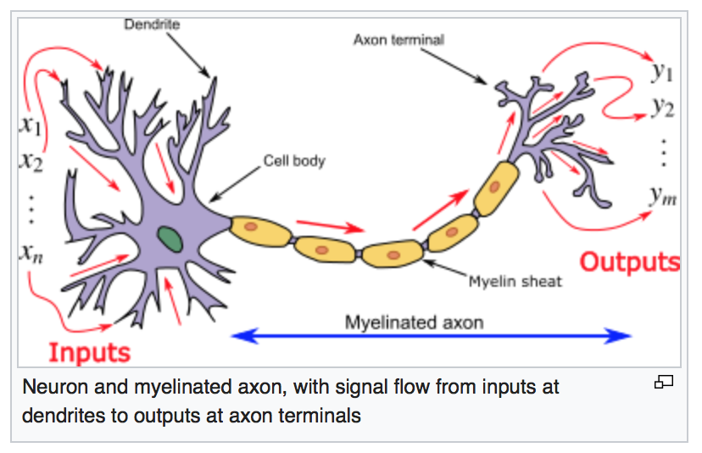
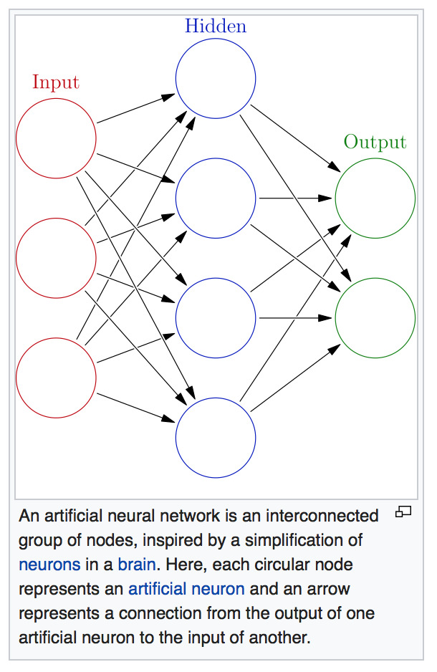
Artificial Neural Networks
Artificial Neural Networks (ANN) or Connectionist Systems are computing systems vaguely inspired by the biological neural networks that constitute animal brains. Such systems "learn" to perform tasks by considering examples, generally without being programmed with task-specific rules.
An ANN is based on a collection of connected units or nodes. Called artificial neurons, which loosely model the neurons in a biological brain. Each connection, like the synapses in a biological brain, can transmit a signal to other neurons. An artificial neuron that receives a signal then processes it and can signal neurons connected to it.

Slide 4
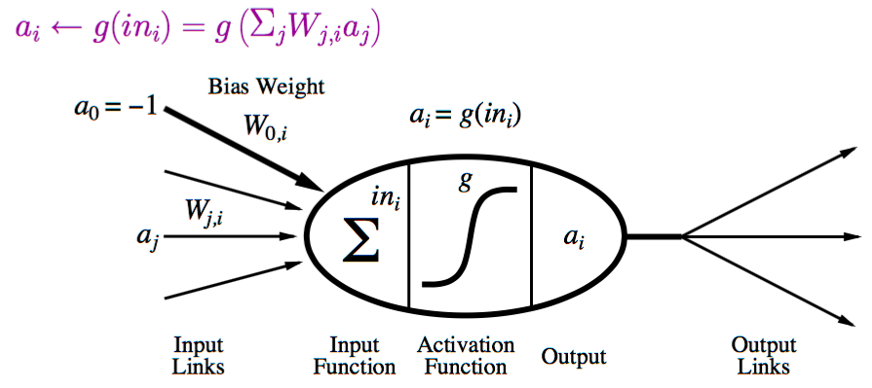
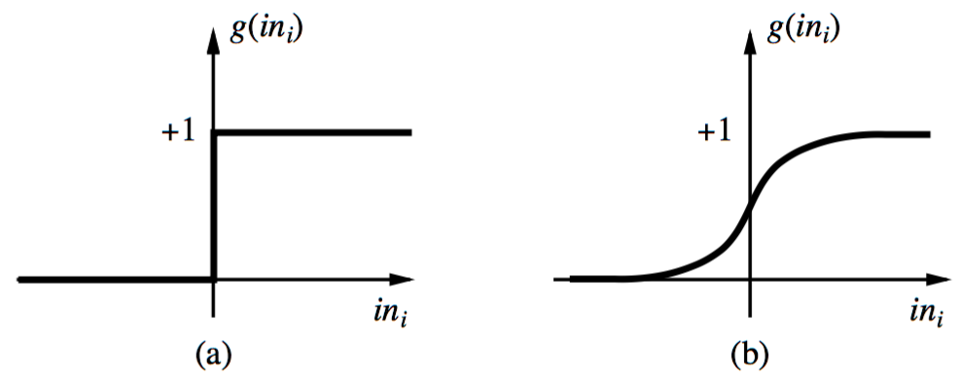
Neural Network: A Neuron
A neuron is a computational unit in the neural network that exchanges messages with each other.
Possible activation functions:
Step function/threshold function
Sigmoid function (a.k.a, logistic function)

Slide 5
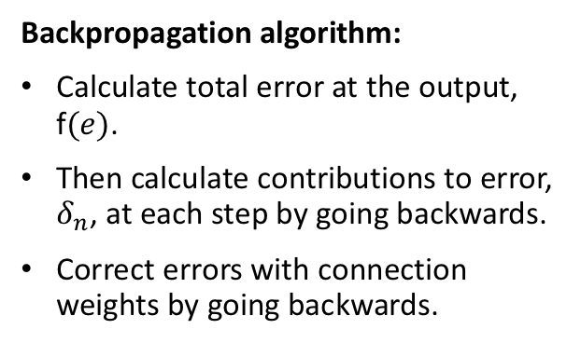
Feed forward Backpropagation Neural Network
Feedforward algorithm:
Randomly initialize the connection weights.
Activate the neurons from the input (x) to hidden then to the output (y) units via activation function and the connection weights.
Backpropagation algorithm:
Calculate total error at the output, f$(e)$.
Then calculate contributions to error, $δ_{n}$, at each step by going backwards.
Correct errors with connection weights by going backwards.

Slide 6
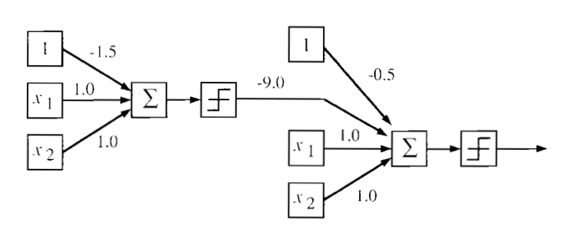
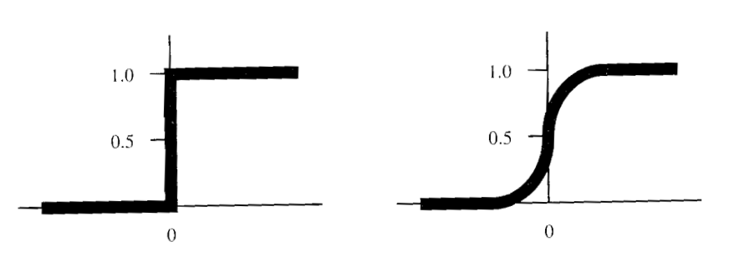
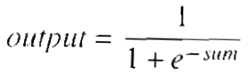
FFBP NN: Representation
Forward Activation:
Input to hidden + hidden to output (summation + transformation)
Stepwise Activation Function
Sigmoid Activation Function

Slide 7
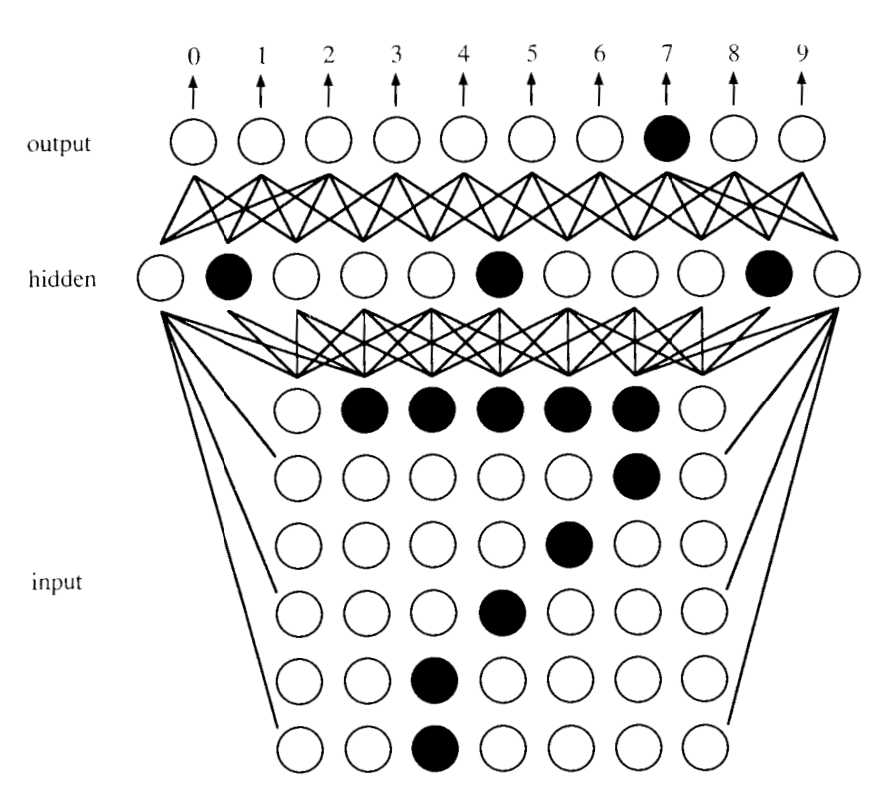
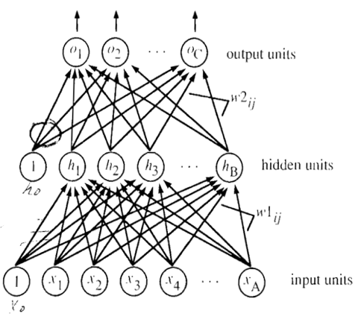

FFBP NN: Representation
A three-layer FFBP NN architecture
E.g., Recognizing digits using a FFBP NN

Slide 8
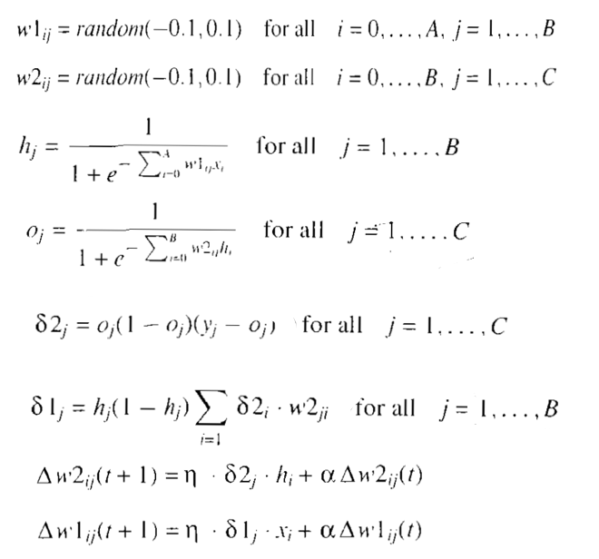

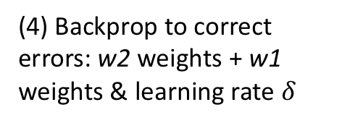


FFBP NN: Algorithm
(1) Initialize random network weights: w1 + w2
(2) Feedforward: input to hidden + hidden to output
(3) Backprop to compute errors: output units + hidden units (gradient descent)
(4) Backprop to correct errors: w2 weights + w1 weights & learning rate $δ$
(5) Repeat 2-4 through epochs

Slide 9
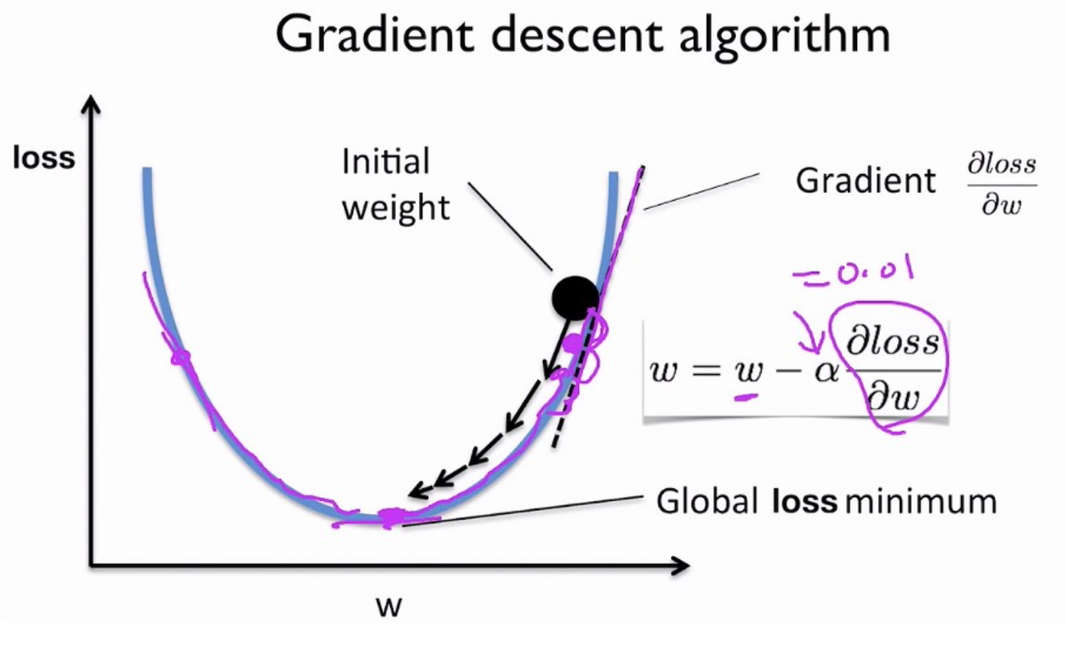
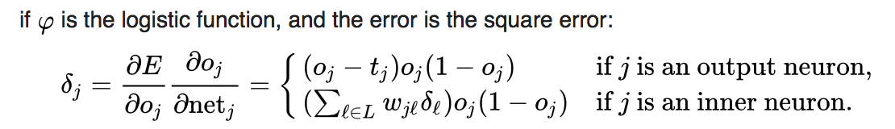
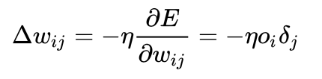
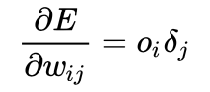
FFBP NN: Gradient Descent
Gradient descent is a first-order iterative optimization algorithm for finding a local minimum of a differentiable function. With gradient descent, we take steps proportional to the negative of the gradient.
Gradient descent is also known as steepest descent.
In Backprop, the gradient descent method is used to calculate the derivative (slope of tangent line to the graph of the function) of the loss function with respect to the weights of the network.

Slide 10
Limitations of FFBP Neural Networks
Random initialization + densely connected networks lead to:
High computational cost (computing slow in 1990s)
Each neuron in the neural network can be considered as a logistic regression. Training the entire neural network is to train all the interconnected logistic regressions.
Difficult to train as the number of hidden layers increases
Too many connection eights to update and compute.
Stuck in local optima
The random initialization does not guarantee starting from the proximity of global optima.
Solution:
Deep Learning: Learning with multiple (deep) levels of representation and specialized learning algorithms
Big data techniques based on cluster computing fast & cheap in the 2010s
Large amount of structured and unstructured data available

Slide 11
Self-Organizing Map
A self-organizing map (SOM) or self-organizing feature map (SOFM) is a type of artificial neural network (ANN) that is trained using unsupervised learning to produce a low-dimensional (typically 2D), discretized representation of the input space of the training samples, called a map.
Self-organizing maps differ from other artificial neural networks as they apply competitive learning as opposed to error-correction learning (such as backpropagation with gradient descent).
SOMs use a neighborhood function to preserve the topological properties (proximity) of the input space. This makes SOMs useful for visualization by creating low-dimensional views of high-dimensional data, akin to multidimensional scaling.
The SOM introduced by the Finnish professor Teuvo Kohonen in the 1980s is sometimes called a Kohonen map.

Slide 12
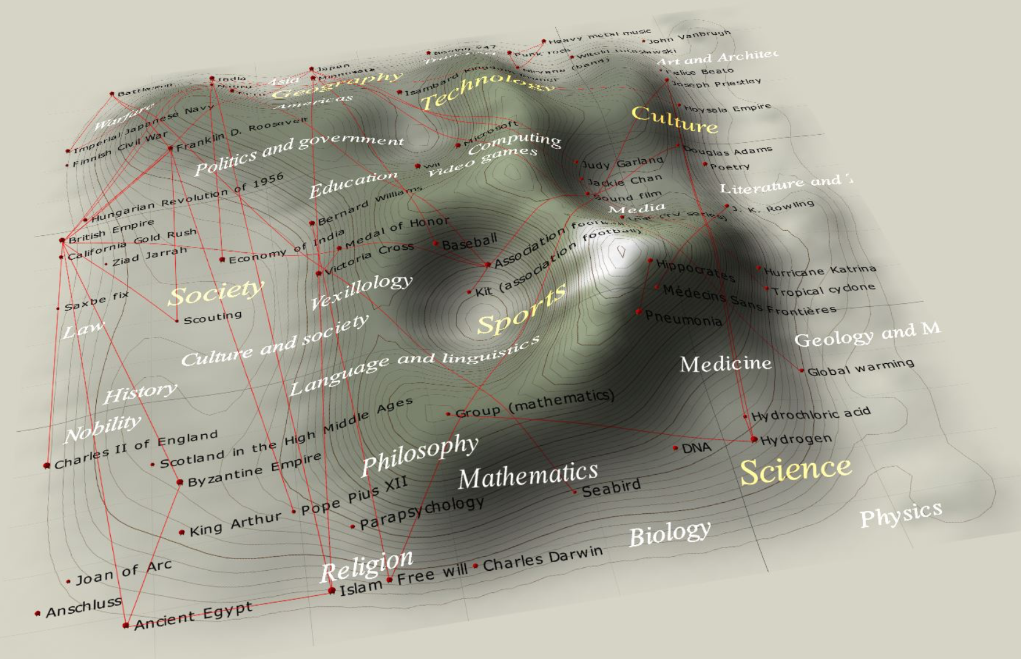
Self-Organizing Map for Text Visualization
Cartographical representation of a self-organizing map based on Wikipedia featured article data (word frequency). Distance is inversely proportional to similarity. The "mountains" are edges between clusters. The red lines are links between articles.

Slide 13
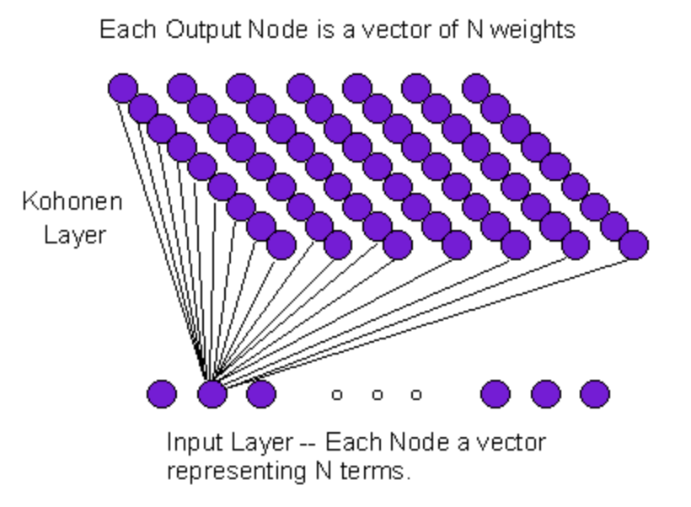
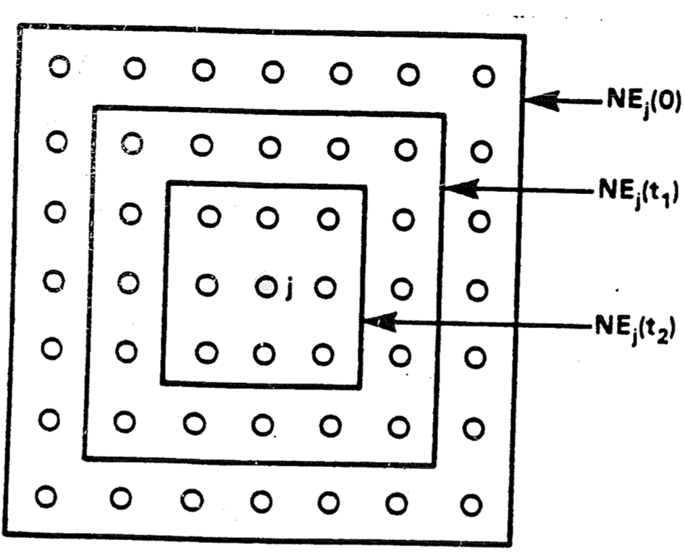
Self-Organizing Map: Representation

Slide 14
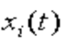
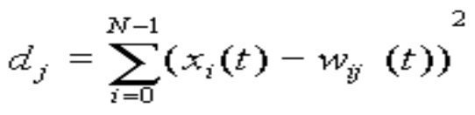
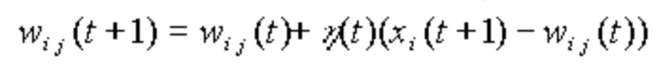
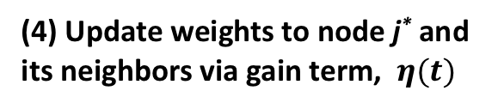
Self-Organizing Map: Algorithm
(1) Initialize input nodes (N), output nodes (M), and (random) connection weights (w_{ij})
N, M, w_{ij}
(2) Present each record/document in order
(3) Compute distance to all nodes and select winning node j*
(4) Update weights to node j* and its neighbors via gain term, $η(t)$
(5) Repeat (2) until convergence

Slide 15
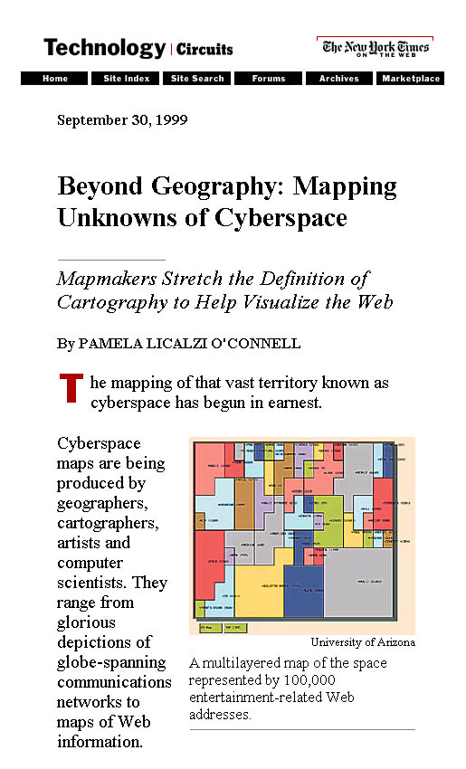
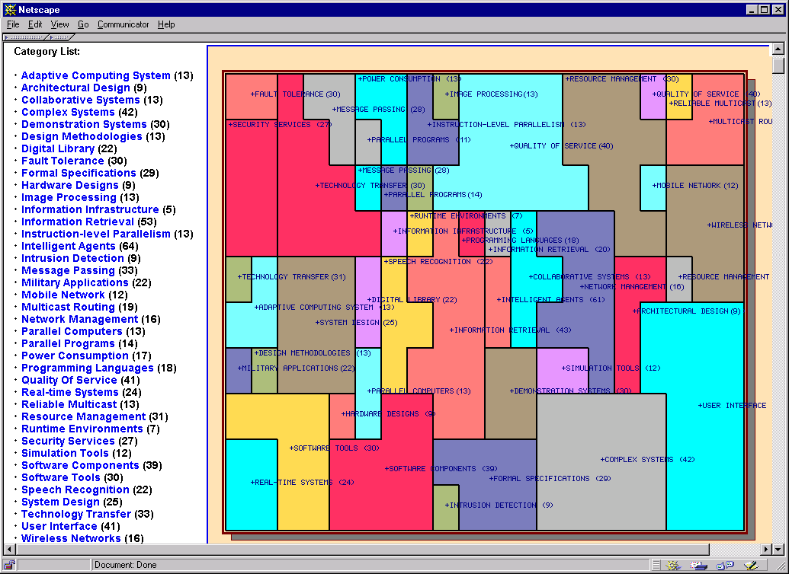
Visualization Research in AI Lab: SOM for Text Analytics and Visualization (Chen et al., 1999)

Slide 16
Visualization Research in AI Lab
From YAHOO! To OOHAY? – Organize the Web
Y
A
H
O
O
!
Y
A
H
O
O
Y
A
H
O
O
Y
A
H
O
O
Object
Oriented
Hierarchical
Automatic
Yellowpage
A
Y
H
O
O
O
O
H
A
Y
O
O
H
A
Y
O
O
H
A
Y
?
O
O
H
A
Y

Slide 17
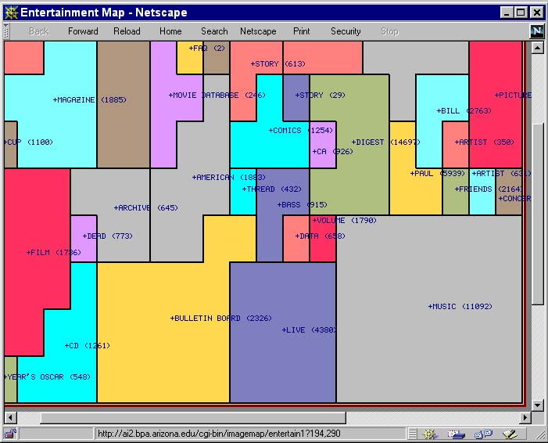
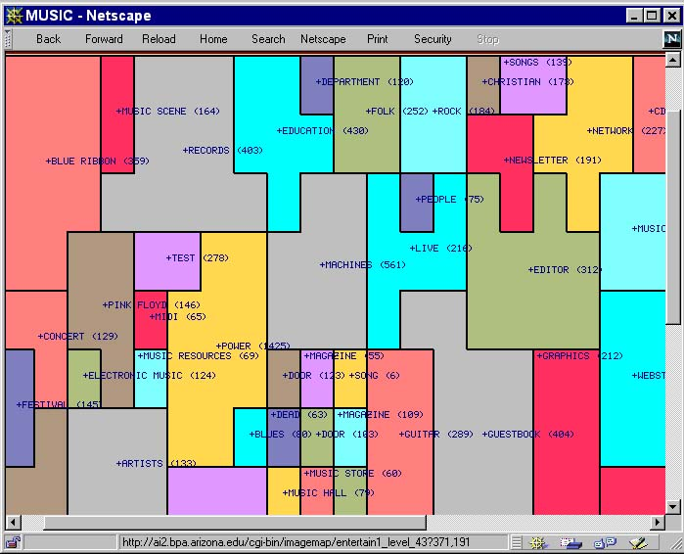
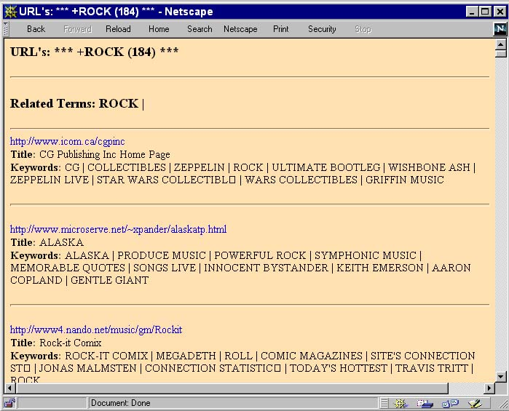
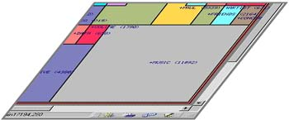
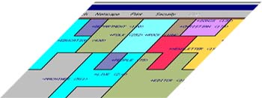
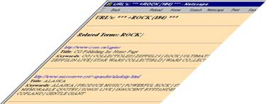
Visualization Research in AI Lab
OOHAY: Visualize the Web
ROCK
MUSIC
… 50
6

Slide 18
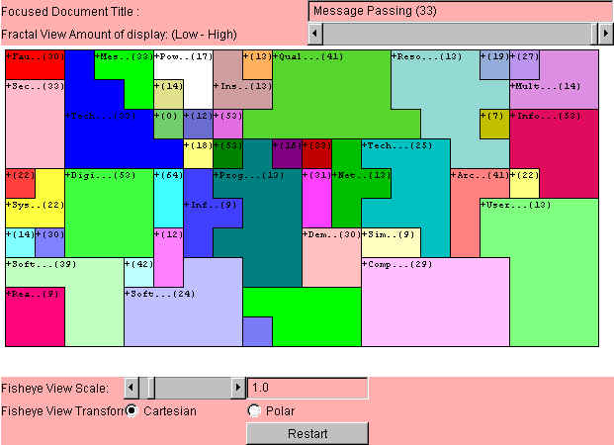
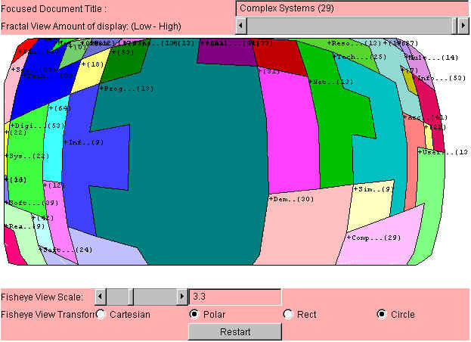
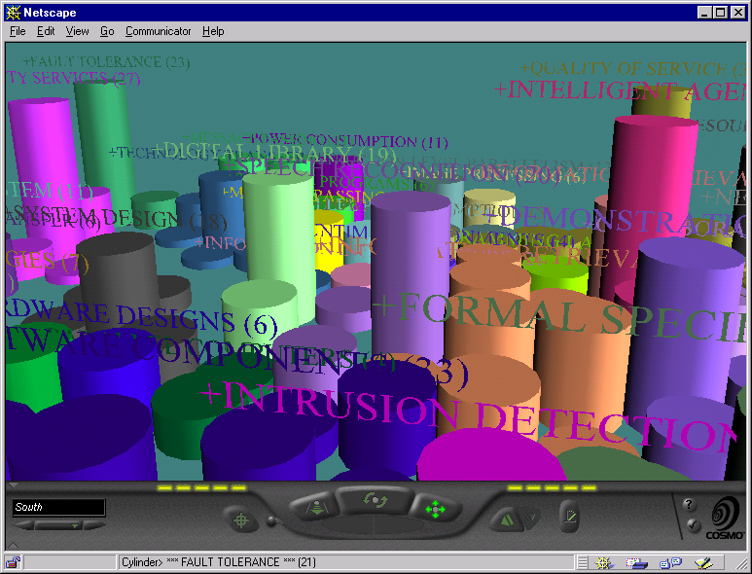
Visualization Research in AI Lab: 2D, 3D and Fisheye
2D SOM
Fisheye View
3D SOM

Slide 19
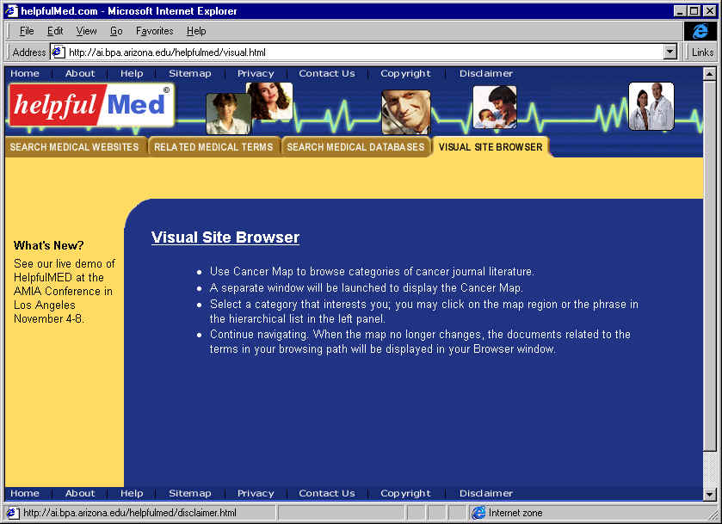
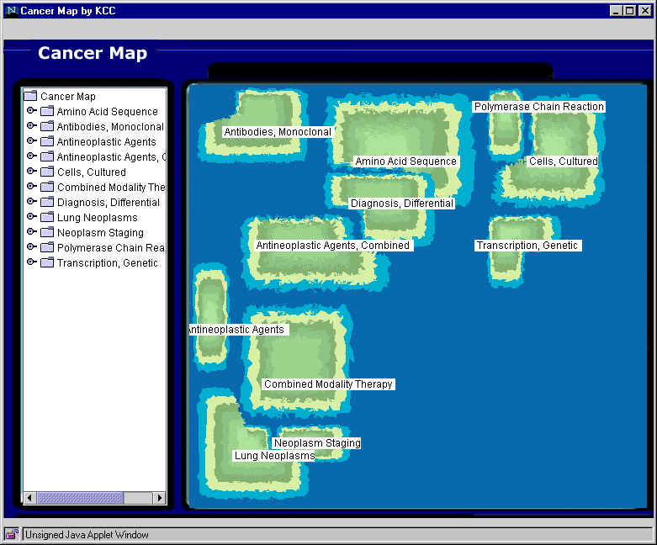
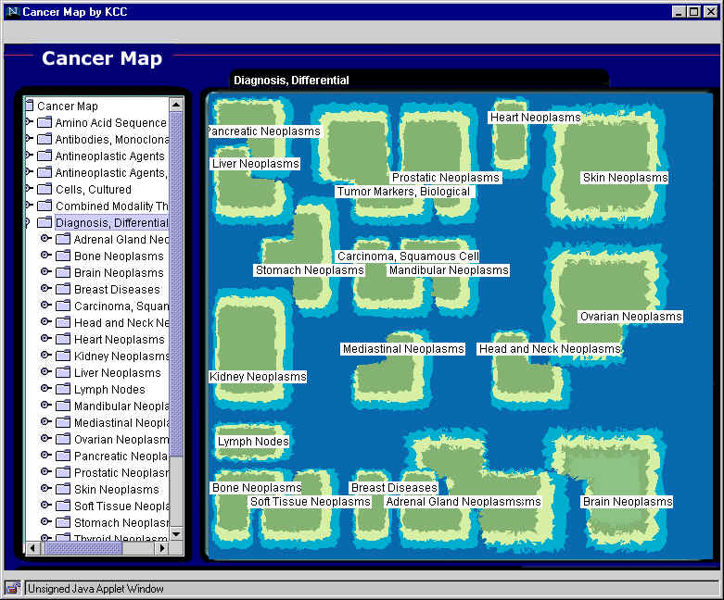
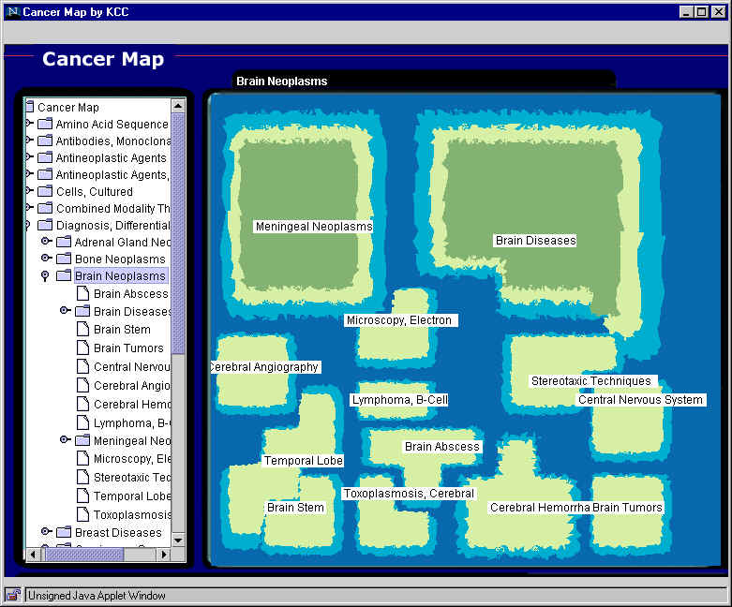
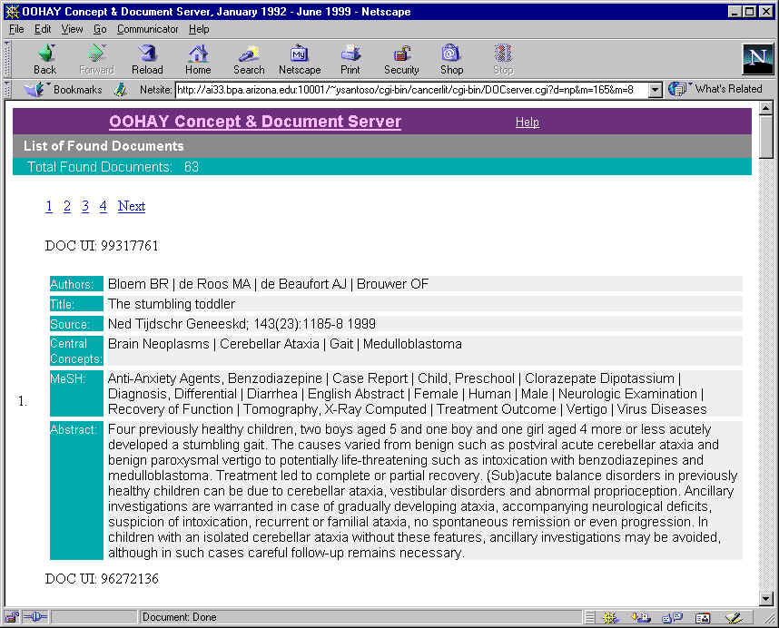
Multi-layer Cancer Map: 2M CancerLit articles, 1500 maps (OOHAY, DLI)
1
Visual Site Browser
2
Top level map
3
Diagnosis, Differential
4
Brain Neoplasms
5
Brain Tumors

Slide 20
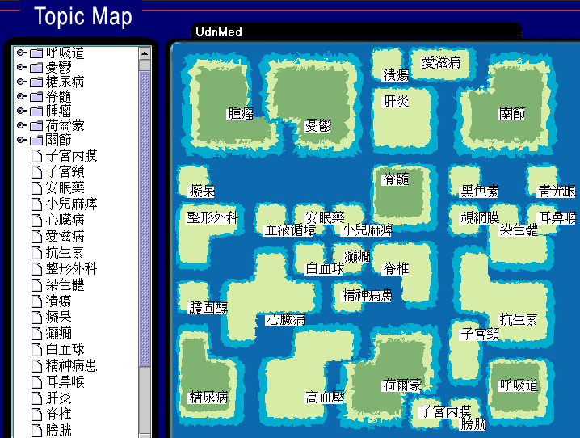
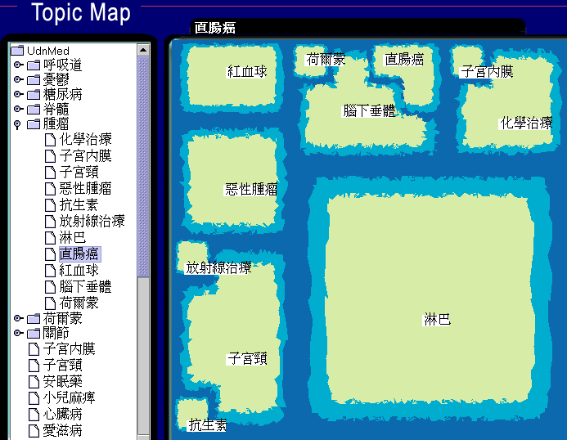
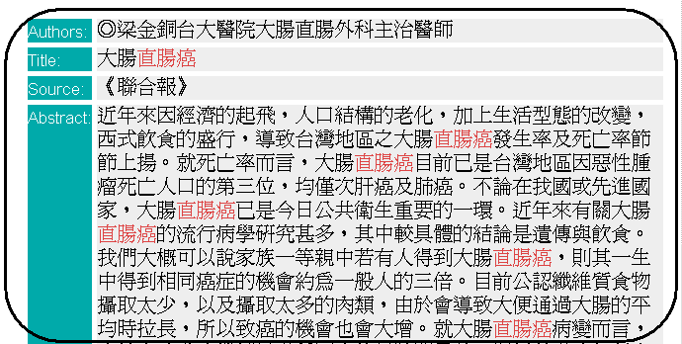
Taiwan Health Map: 500K Chinese Health News articles

Slide 21
References
T. Kohonen, “Self-Organizing Map”, 1993
R. Lippmann, “Introduction to Computing with Neural Networks”, 1987
UIUC DLI Research Project (co-PI Hsinchun Chen, University of Arizona), NSF Digital Library Initiative Program, 1994-1998

